Slide 1



IUMRS-International Conference on Electronic Materials 2012
Sept.23 – 28, 2012 Pacifico Yokohama, Yokohama, Japan
Self-cooling on power MOSFET using copper plating single-crystalline silicon wafers
Yokohama National University*, National Defense Academy¹⁾, Chubu University²⁾
H.Nakatsugawa*, Y.Okamoto¹⁾, T.Kawahara²⁾, S.Yamaguchi²⁾
Notes:
Thank you Mr Chairman.
My name is Hiroshi Nakatsugawa from Yokohama National University.
It is my great honor to be invited such an opportunity.
Today, I’m going to talking about “Self-cooling on power MOSFET using copper plating single-crystalline silicon wafers”

Slide 2
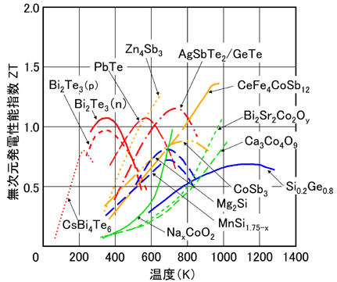
Introduction
Low Temp
Mid Temp
High Temp
Low Temp
Bi₂Te₃
Mid Temp
Mg₂Si, MnSi_{1.75-γ}
CoSb₃
High Temp
Na_{x}CoO₂
Ca₃Co₄O₉
CaMnO₃
Silicon wafer
Notes:
Thermoelectric generation is very important from a point view of waste heat utilization. In order to realize 10% of energy conversion efficiency, ZT value needs to be above 1.
This figure shows ZT values of thermoelectric materials.
In the low temperature, bismuth telluride has high ZT value.
In the middle temperature, silicide and skutterudite attract attention.
In the high temperature, single-crystalline oxides have high performance.
But ZT values of polycrystalline oxide and single-crystalline silicon are very low.

Slide 3
polycrystalline oxide
・stable in High Temp
・waste heat utilization, emergency power source
single-crystalline silicon
・application of self-cooling device using high thermal conductivity
Notes:
Polycrystalline oxide is stable in the high temperature, and shows low resistivity and high Seebeck coefficient.
So, polycrystalline oxide can be applied to waste heat utilization or emergency power source.
On the other hand, single-crystalline silicon shows low resistivity, high Seebeck coefficient, and low ZT value because of high thermal conductivity.
So, single-crystalline silicon is expected to be application of self-cooling device using high thermal conductivity.

Slide 4
Purpose
polycrystalline oxide
single-crystalline silicon
thermoelectric generation
element
thermoelectric cooling
element
self-cooling device
heat release
n
p
n
p
MOSFET
load
source
heat release
Notes:
The purpose of this study is to show application of thermoelectric generation for polycrystalline oxide and self-cooling device for single-crystalline silicon.

Slide 5
① self-cooling for single-crystalline silicon
② themoelectric generation for polycrystalline oxide
Notes:
First of all, I’m going to talk about self-cooling for single-crystalline silicon.

Slide 6
thermoelectric cooling
heat absorption
n
p
n
p
heat release
current
heat
absorption
heat
release
CB
CB
CB
current
E_{F}
electron
VB
VB
VB
Notes:
Thermoelectric cooling is realized by the cycle of Peltier heat absorption and heat release.
But high-current cannot be passed because of a large Joule heat.

Slide 7
self-cooling
current
heat release
heat
absorption
heat
release
CB
E_{F}
VB
MOSFET
self-cooling
heat
release
heat
absorption
CB
E_{F}
current
heat release
VB
electron
Notes:
On the other hand, self-cooling is realized by the thermal conduction and the Peltier heat absorption.
In this case, high-current can be passed because of a small Joule heat.

Slide 8
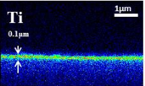
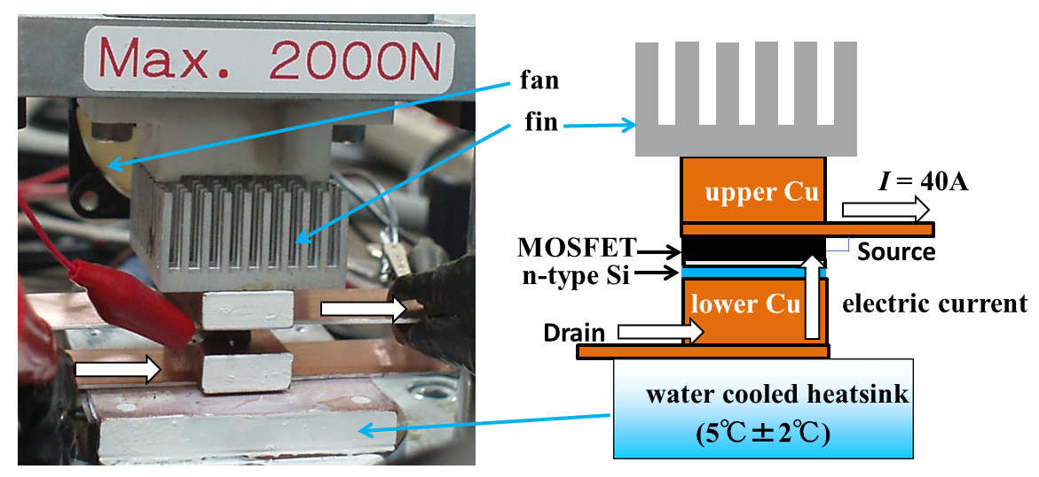
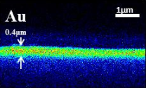
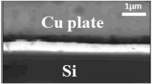
Method
resistivity
thermoppwer
carrier concentration
carrier mobility
193μV/K
10mΩcm
－200μV/K
3mΩcm
RI² = 139 mW @ I = 40A
R = 0.087 mΩ @ RT
Ti 0.1μm
Sb doped n-type Si wafer
Cu
Au
Ti
Au 0.4μm
Si
0.52mm thick
30mm
20mm
Gate-Source V: 10V, Drain-Source I: 40A
The temperature measurement using infrared thermography every 10 minutes in two hours
The voltage measurement between Drain and Source
B doped p-type Si wafer
R = 0.026 mΩ @ RT
RI² = 42 mW @ I = 40A
Notes:
The electrode was fabricated on both surfaces by coating titanium and gold sputtering and copper plating.
This figure shows experimental setup, where white arrow shows the electric current of 40A.
MOSFET and single-crystalline silicon was located between copper blocks.
The temperature measurement was carried out using infrared thermography every 10 minutes in two hours.
The voltage between Drain and Source was also measured.

Slide 9
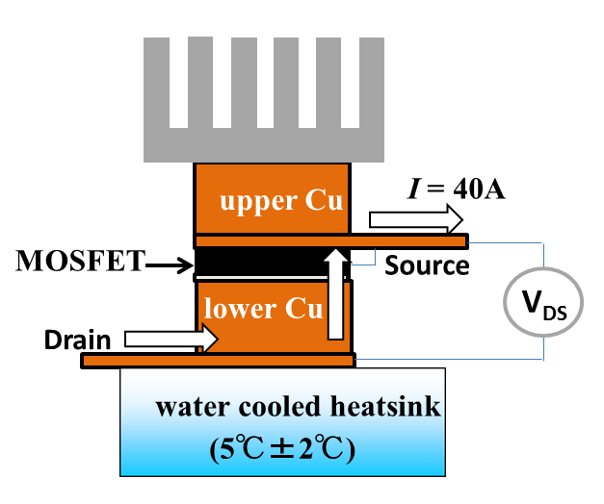
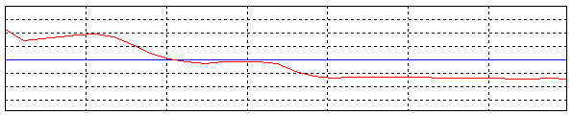
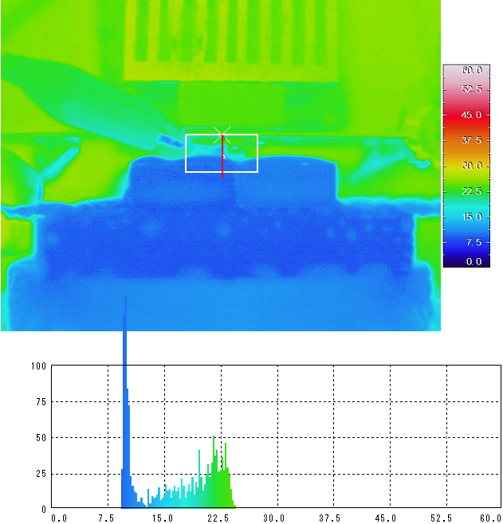
Results: MOSFET only (40A)
30
upper side temperature: 21.3℃
Joule heat from MOSFET 2.52W
temperature （℃)
●
internal temperature: 13.8℃
15
●
lower side temperature: 9.4℃
0
line profile
●
63mV
30
●
temperature （℃)
15
0
line profile
120min
17.4℃±0.6℃
11.6℃±0.8℃
pixel value
temperature （℃)
Notes:
This is the result when MOSFET is located between upper and lower copper blocks.
The temperatures of top and bottom side of MOSFET are measured by using the line profile of the infrared thermography.

Slide 10
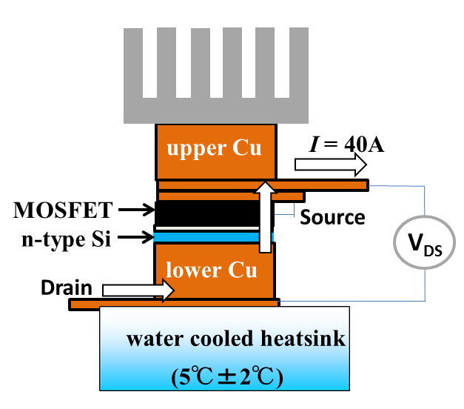
Results: MOSFET+n-Si (40A)
Joule heat from MOSFET 2.52W
Joule heat from MOSFET 2.52W
●
118mV
Peltier heat from n-Si 2.06W
●
63mV
●
●
172μV/K
0.14W
Joule heat from n-Si
－0.8℃
17.4℃±0.6℃
16.6℃±0.4℃
11.6℃±0.8℃
10.9℃±0.6℃
－0.7℃
Notes:
This is the result when MOSFET with n-type silicon is located between upper and lower copper blocks.
A small cooling effect can be found.
But this is in the experimental error.
So, we have tried to modify the experimental setup.

Slide 11
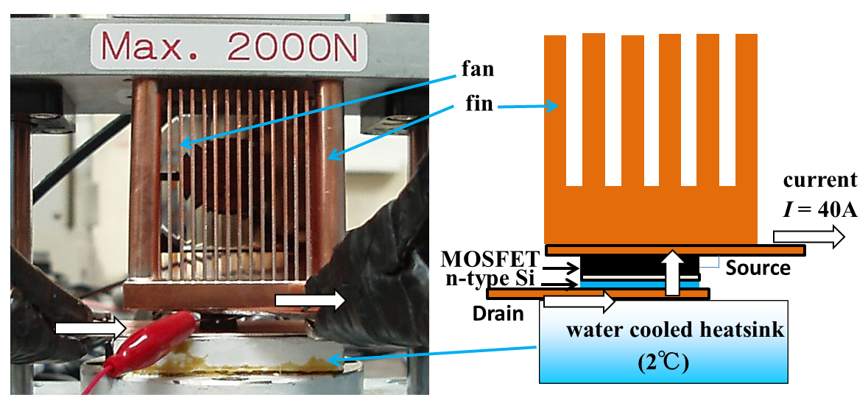
Notes:
The fin made of stainless-steel was exchanged for the fin made of copper.
Then, MOSFET and single-crystalline silicon were located between fin and heatsink directly.
In addition, the water temperature in the heatsink was maintained 2℃ by the cooling water circulation system with ice.

Slide 12
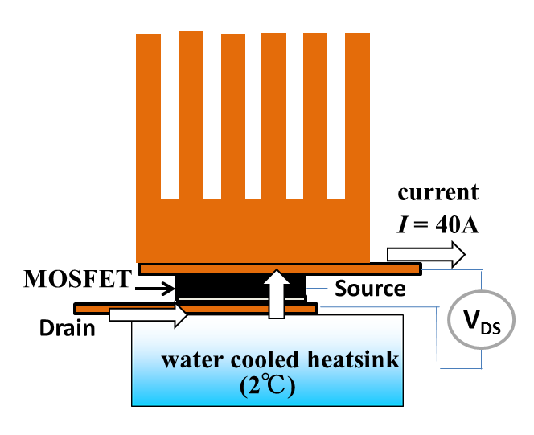
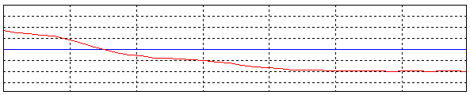
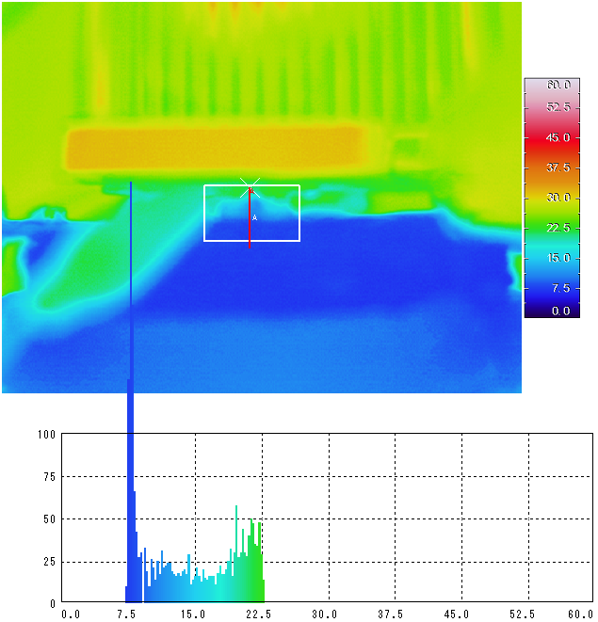
Results: MOSFET only (40A)
30
upper side temperature: 20.6℃
temperature （℃)
●
Joule heat from MOSFET 1.84W
15
●
internal temperature: 11.3℃
lower side temperature: 7.5℃
0
line profile
30
●
46mV
temperature （℃)
●
15
0
line profile
120min
16.4℃±0.4℃
9.5℃±0.4℃
pixel value
temperature （℃)
Notes:
This is the result when MOSFET is located between fin and heatsink.
The average temperatures of top and bottom side of MOSFET are 16.4℃ and 9.5℃.

Slide 13
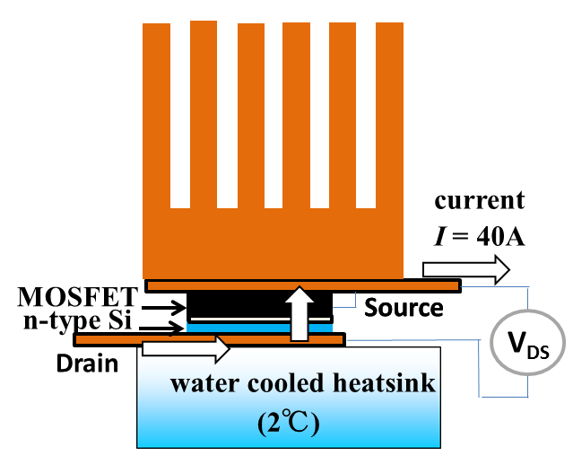
Results: MOSFET+n-Si (40A)
Joule heat from MOSFET 1.84W
Joule heat from MOSFET 1.84W
Peltier heat from n-Si 0.74W
●
46mV
●
68mV
●
62μV/K
●
0.14W
Joule heat from n-Si
－1.9℃
16.4℃±0.4℃
14.5℃±0.4℃
9.5℃±0.4℃
8.0℃±0.5℃
－1.5℃
Notes:
This is the result when MOSFET with n-type silicon is located between fin and heatsink.
The average temperature of top side of MOSFET decreases 1.9℃.
And the average temperature of bottom side of MOSFET decreases 1.5℃.

Slide 14
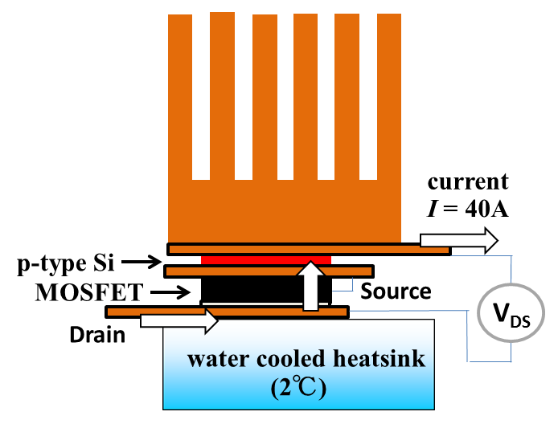
Results: MOSFET+p-Si (40A)
Joule heat from MOSFET 1.84W
Joule heat from MOSFET 1.84W
Peltier heat from p-Si 0.56W
●
46mV
61mV
●
47μV/K
●
●
0.04W
Joule heat from p-Si
－0.7℃
16.4℃±0.4℃
15.7℃±0.4℃
9.5℃±0.4℃
8.5℃±0.4℃
－1.0℃
Notes:
This is the result when MOSFET with p-type silicon is located between fin and heatsink.
The average temperature of top side of MOSFET decreases 0.7℃.
And the average temperature of bottom side of MOSFET decreases 1℃.

Slide 15
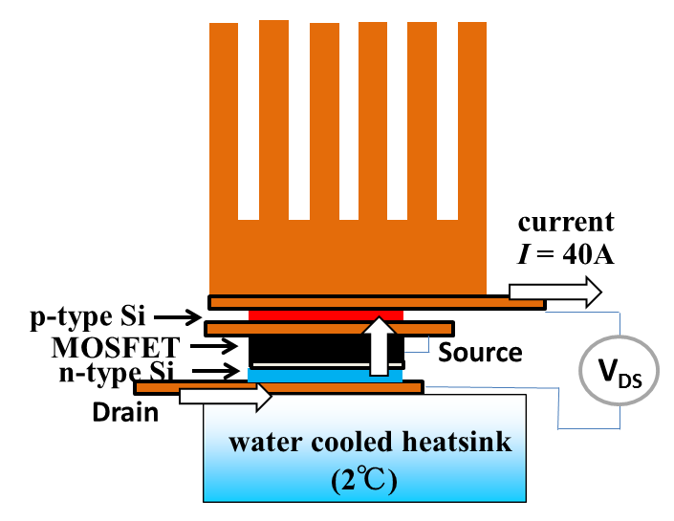
Results: MOSFET+n-Si+p-Si (40A)
Joule heat from MOSFET 1.84W
Joule heat from MOSFET 1.84W
Peltier heat from n-Si & p-Si 0.78W
70mV
65μV/K
●
46mV
●
●
●
0.18W
Joule heat from n-Si & p-Si
－1.3℃
16.4℃±0.4℃
15.1℃±0.5℃
9.5℃±0.4℃
8.2℃±0.5℃
－1.3℃
Notes:
This is the result when MOSFET with n and p-type silicons is located between fin and heatsink.
The average temperature of top side of MOSFET decreases 1.3℃.
And the average temperature of bottom side of MOSFET also decreases 1.3℃.

Slide 16
① self-cooling for
single-crystalline silicon
② themoelectric generation for
polycrystalline oxide
Notes:
Next, I’m going to talk about thermoelectric generation for polycrystalline oxide.

Slide 17
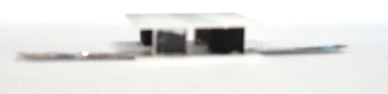
Method
n-type thermoelectric elements： Yb doped CaMnO₃
p-type thermoelectric element： Y doped Ca₃Co₄O₉
Mn₃O₄ + CaCO₃ + Yb₂O₃
Co₃O₄ + CaCO₃ + Y₂O₃
solid-state reaction: 1300℃ in air
Ca_{0.99}Yb_{0.01}MnO₃
solid-state reaction: 920℃ in O₂
[(Ca_{0.9}Y_{0.1})₂CoO₃]_{0.62} CoO₂
silver paste coating
silver sheet
annealed at 850℃ in air
cubic,
6mm on a side
p
n
n
p
silver paste coating
n
p
2 PN pair
thermoelectric module
n-type
element
p-type
element
serial connection
Notes:
Ytterbium doped calcium manganese oxide was used for n-type thermoelectric element.
And yttrium doped calcium cobalt oxide was used for p-type thermoelectric element.
These elements were cut for cubic of 6mm on a side.
Silver paste coating thermoelectric elements were serial connected on silver sheet and annealed at 850℃ in air.
Then, we get 2 PN pair thermoelectric module.

Slide 18
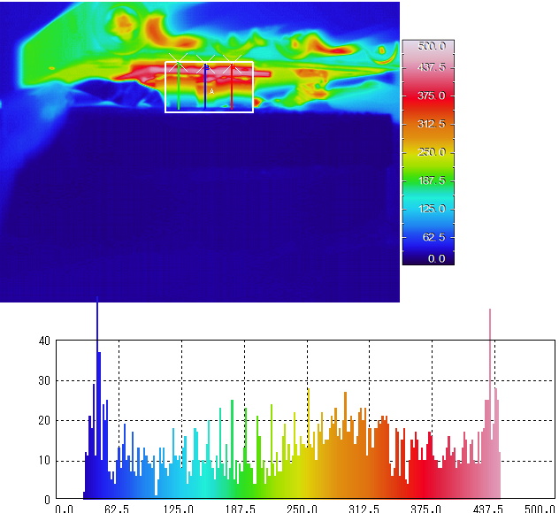

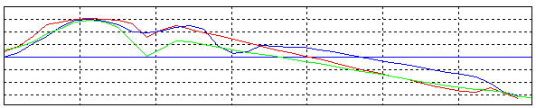
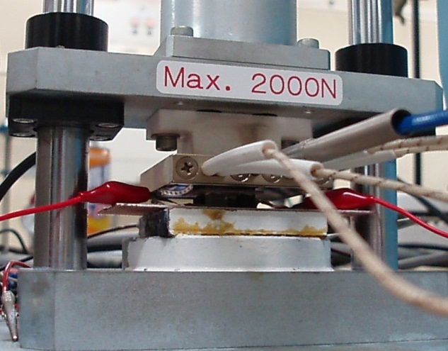
Results: temperature difference
Temperature (℃)
0
500
heater : 500℃
T_{H}=709K
heater : 600℃
TE module
TE module
18℃
water cooled heatsink
line profile
water cooled heatsink
T_{L}=330K
pixel value
Temperature (℃)
500
T_{H}=709K
Temperature (℃)
⊿T=379K
250
T_{L}=330K
0
line profile
Notes:
The temperature difference was estimated 379K by using the line profile of the infrared thermography.

Slide 19
Results: average r and S values
⊿T
⊿T
94.3mΩcm
149.5μV/K
54.7mΩcm
－271.5μV/K
r = 0.51Ω
|S| = 842μV/K
PN 2pairs
PN 2pairs
Notes:
In the temperature range, the average internal resistance and Seebeck coefficient of the thermoelectric module are found 0.51Ω and 842μV/K, respectively.

Slide 20
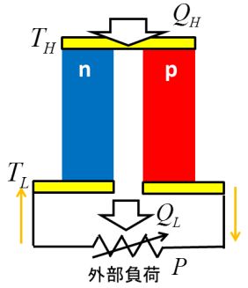
Results: power performance
⊿T=399K
≒379K
PN 2pairs
34mW
PN 1pair
r+R=0.82Ω
R=0.31Ω
Notes:
This figure shows voltage-current line and current-power curve of the thermoelectric module.
From the open-circuit voltage, we can get the temperature difference 399K.
This is in good agreement with the value from infrared thermoraphy.
From maximum current, we can get the contact resistance 0.31Ω.
And maximum power is 34mW.
This means 17mW per PN pair.
In addition, energy conversion efficiency can be found 0.21%.

Slide 21
Results: optimization of element size
PN 2pairs
6mm
6mm
n
p
6mm
6mm
6mm
6mm
0.82
5.6
Notes:
If the element shape is cubic, the internal resistance is in inverse proportion to the element length and the contact resistance is in proportion to the element area.
So, the module resistance has minimum at the element length of 5.6mm.
Fortunately, the element size is in good shape.

Slide 22
Conclusion
We try to show the application of the self-cooling device for single-crystalline silicon.
The self-cooling of top and bottom side of MOSFET with n-type and/or p-type Si can be found in the electric current of 40A.
We try to show the application of thermoelectric generation for polycrystalline oxide.
In the temperature difference 399K, the maximum power per PN pair can be found 17mW.
Notes:
In conclusion,
・We try to show application of the self-cooling device for single-crystalline silicon.
・The self-cooling of top and bottom side of MOSFET with n-type and/or p-type Si can be found in the electric current of 40A.
・We try to show application of thermoelectric generation for polycrystalline oxide.
・In the temperature difference 399K, the maximum power per PN pair can be found 17mW.

Slide 23
IUMRS-International Conference on Electronic Materials 2012
Sept.23 – 28, 2012 Pacifico Yokohama, Yokohama, Japan
Thank you for your kind attention.
Notes:
Thank you for your kind attention.

